Slide 1
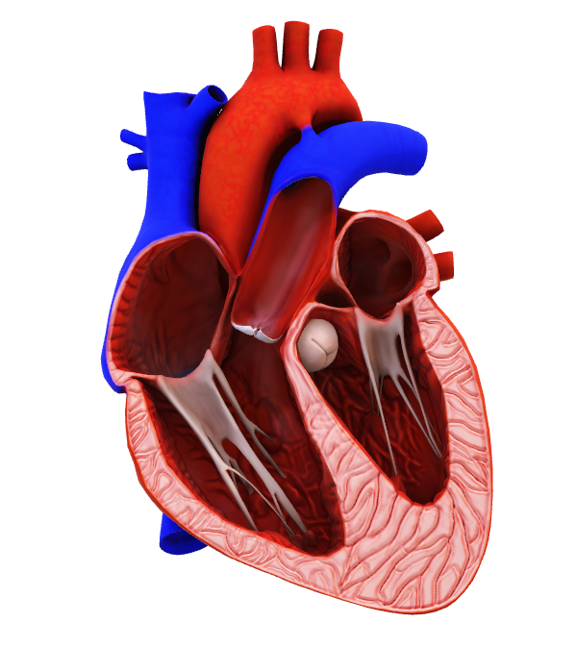
Heart Disease Risk Analysis & Interactive Dashboard using Power BI
Presented by: Kamatchi Lalitha . R Dataset: Heart Disease Dataset Tool Used: Power BI
Course : Da & Ds/ June-25 Institution: KGiSL MicroCollege

Slide 2
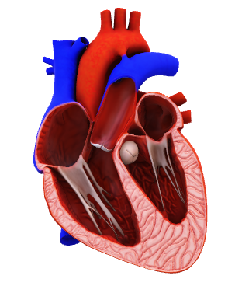
Problem Statement
Heart disease is one of the leading causes of death worldwide. However, early detection and understanding of risk factors can significantly reduce mortality.
Problem: Healthcare providers lack visual, data-driven insights to quickly identify high-risk patients.
Objective: To analyze heart disease data and build an interactive dashboard that helps identify:
High-risk age groups
Gender-based risk

Slide 3
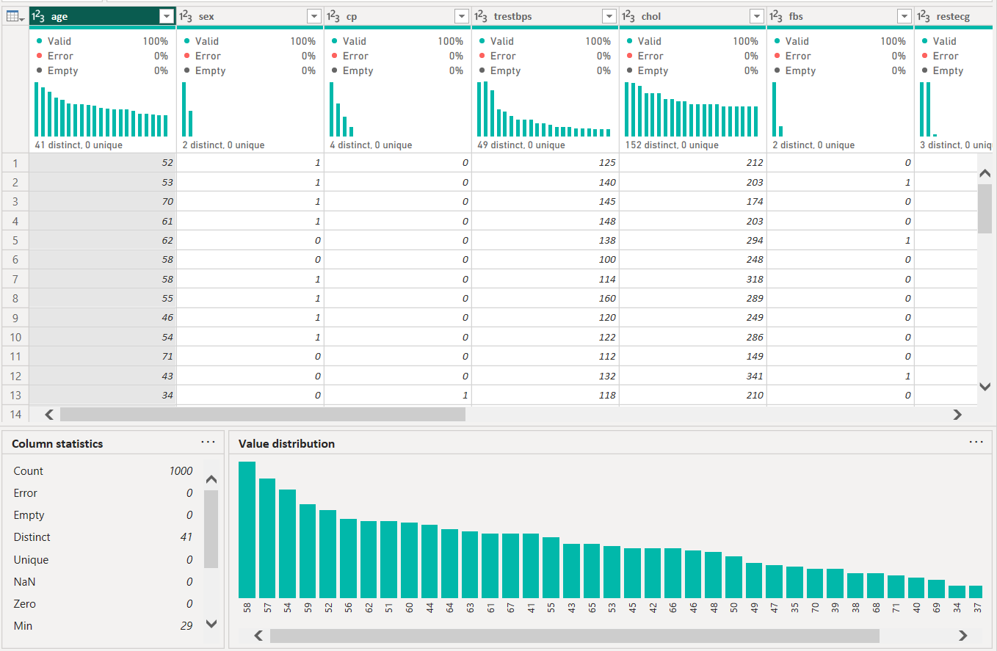

Dataset Overview
Dataset Name: Heart Disease Dataset
Source: Public Healthcare Dataset
Number of Records: 1339 rows Number of Columns: 44
Key Columns: 9
Age
Sex
Chest Pain Type (cp)
Resting Blood Pressure
Cholesterol
Fasting Blood Sugar
Maximum Heart Rate
Exercise Induced Angina
Heart Disease (Target)

Slide 4
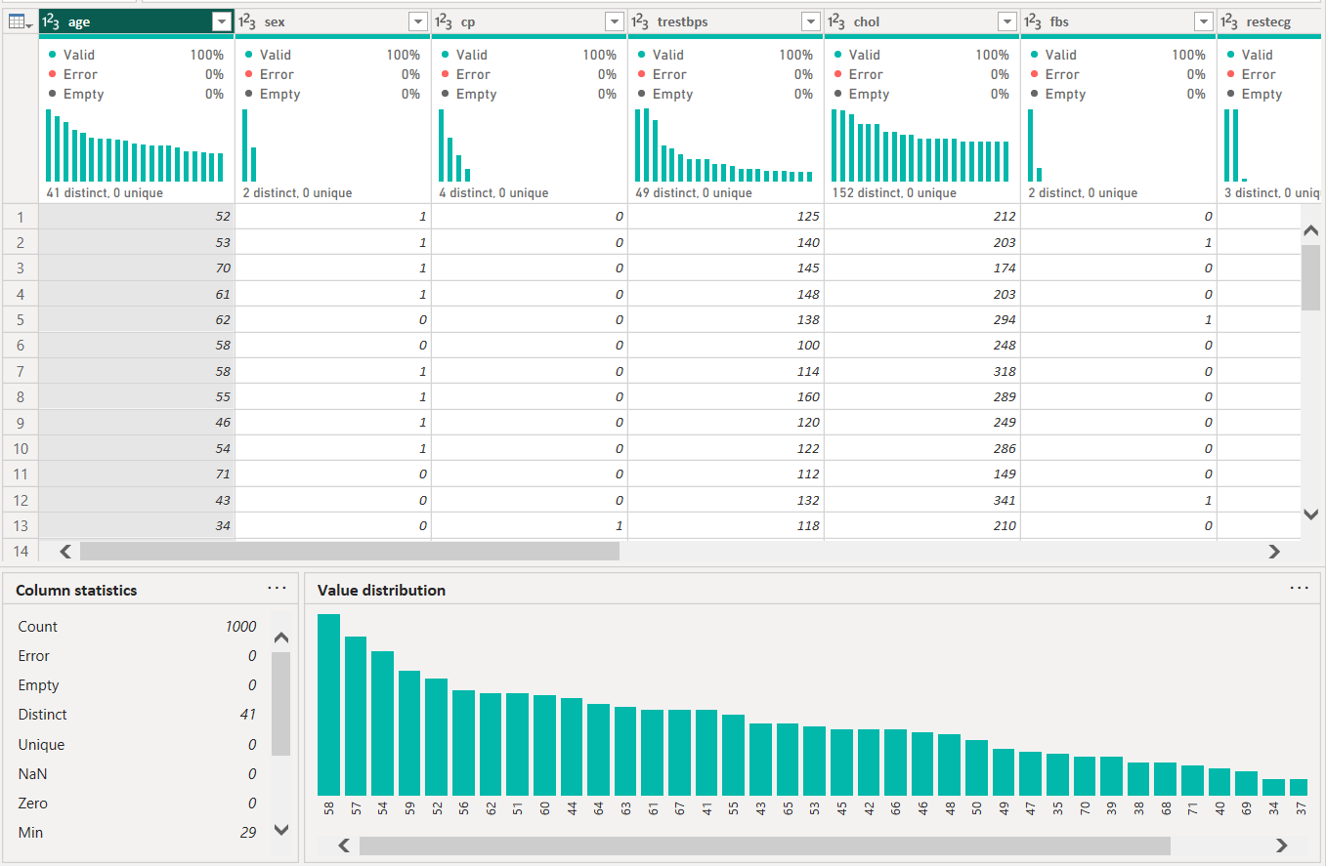

Data Cleaning & Transformation
Data cleaning was performed using Power Query Editor.
Steps Performed: Verified missing values (100% data completeness)
Corrected data types (numeric & categorical)
Converted binary columns (0/1) to meaningful labels
Renamed columns for better readability
Removed unnecessary columns (if any)
Result : Clean, structured, and analysis-ready dataset.
Dataset contains 1339 rows and 44 columns with null values
Removed Duplicates

Slide 5
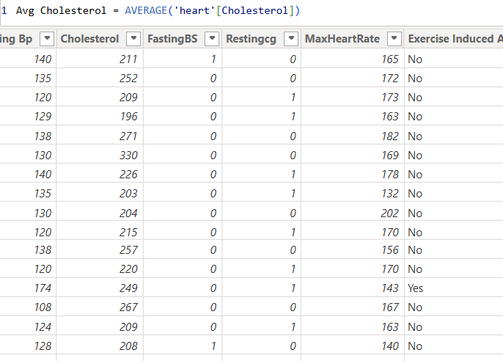
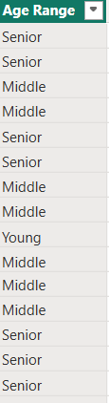

PERFORMED DAX Functions
To improve analysis, new fields were created.
New Columns Created:
Age Group (Young, Middle Age, Senior)
Gender Label (Male / Female)
Heart Disease Status (Yes / No)
DAX Measures Created:
Total Patients
Total Heart Disease Cases
Male vs Female Patients
Heart Disease Percentage
These calculations enabled clear KPI visualization.

Slide 6
Dax formulae's for measures & Calculated columns
Total Patients = COUNTROWS('Heart')Total Male Patients
Total Male Patients =CALCULATE(
COUNTROWS('Heart'), 'Heart'[Gender] = "Male")Total Female Patients
Total Female Patients =CALCULATE( COUNTROWS('Heart'), 'Heart'[Gender] = "Female")
Male % =DIVIDE( [Total Male Patients], [Total Patients], 0) * 100
Female % =DIVIDE( [Total Female Patients], [Total Patients], 0) * 100
Avg Cholesterol = AVERAGE('heart'[Cholesterol])
If Gender = 1 → Male
Total Male Patients = CALCULATE( COUNTROWS('Heart'), 'Heart'[Gender] = 1 )
If Gender = 0 → Female
Total Female Patients = CALCULATE( COUNTROWS('Heart'), 'Heart'[Gender] = 0 )
Heart Disease % =
DIVIDE(
CALCULATE(COUNT(target), target = 1),
COUNT(target)
)
If Age < 30 → Young
Else if Age ≤ 50 → Middle Age Else → Senior
Condition | Value | Output
chol < 200 | Normal
chol ≤ 239 | Borderline
Else | High
Avg Risk Score = AVERAGE('heart'[Risk Score])

Slide 7
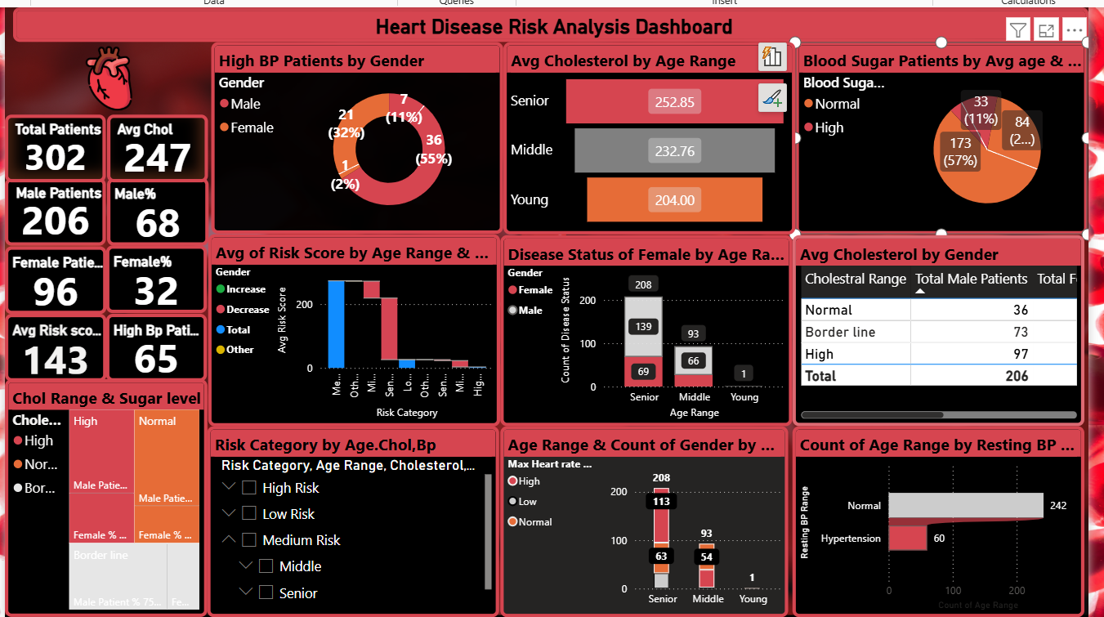
Heart Disease Risk Analysis using Power bi

Slide 8
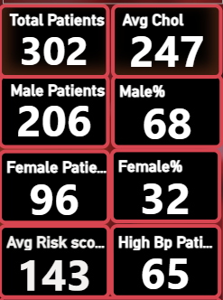
Kpi cards
Overview / Key Metrics (Top Left Cards)
Total Patients: 302
Gender Split: 206 Males (68%), 96 Females (32%) → Shows a higher male patient prevalence.
Average Cholesterol: 247 mg/dL → Indicates borderline to high cholesterol on average.
Average Risk Score: 143 → Suggests moderate overall risk.
High BP Patients: 65 → Significant number have hypertension.
“The dataset consists of 302 patients, with males forming the majority (68%). The average cholesterol level is slightly high at 247 mg/dL, and 65 patients have high blood pressure, indicating a considerable prevalence of heart disease risk factors.”

Slide 9
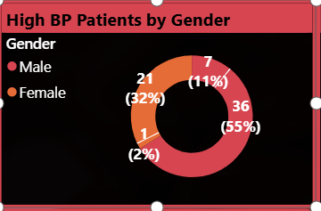
High BP Patients by Gender (Donut Chart)
Males: 36 (55%)Females: 7 (11%)Male dominance in high BP cases is evident.
:“High blood pressure is more prevalent among males, accounting for 55% of all hypertensive patients, compared to only 11% in females.”

Slide 10
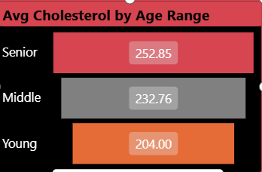
Average Cholesterol by Age Range (Bar Chart)
Young: 204 mg/dL
Middle-aged: 232.76 mg/dL
Senior: 252.85 mg/:
“Cholesterol levels increase with age. Seniors have the highest average cholesterol (252.85 mg/dL), which is above the healthy threshold, highlighting the need for targeted intervention in older age groups.”

Slide 11
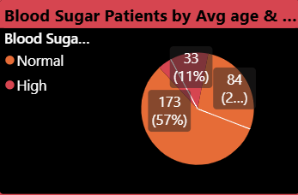
Blood Sugar Patients by Avg Age (Pie Chart)
High Blood Sugar: 84 (28%)Normal: 173 (57%)Indicates 28% of patients are hyperglycemic.
“Around 28% of patients have high blood sugar, reinforcing the link between diabetes and heart disease risk.”

Slide 12
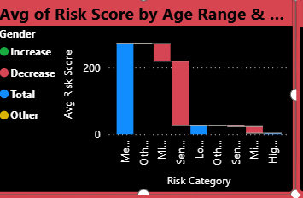
Avg Risk Score by Age & Gender waterfall Chart)
Senior & Middle age groups have higher average risk scores.
Gender comparison (Increase vs Decrease) shows trends in risk elevation.
“Risk scores increase with age. Seniors show the highest risk, highlighting age as a key factor for cardiovascular issues.”

Slide 13
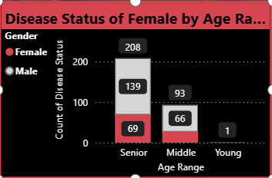
Disease Status of Females by Age (Stacked Bar Chart)
Senior: 208 total, 69 with disease
Middle: 93 total, 66 with disease
Young: 1 patient with
Among females, middle-aged and senior patients have the highest disease count. Preventive measures should prioritize these age groups.”

Slide 14
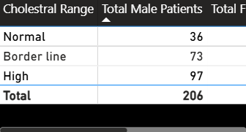
Avg Cholesterol by Gender
Cholesterol issues are more prominent in males, with 97 patients falling in the high range. This highlights gender-specific heart disease risk.”
Gender
Total Female Patients: Number of female patients in each cholesterol category.
Female %: Percentage of total female patients in each cholesterol group.
Key Insight: 31.8% of patients are female, with most females (37.4%) in the mid-range cholesterol group; males make up 68.2%.

Slide 15
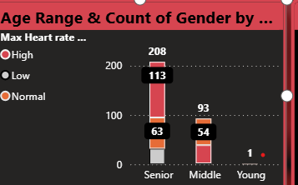
Age Range & Count of Gender by Max Heart Rate
High max heart rate: 208 seniors
Low: 63 seniors
Middle and young have lower counts
Insights:“Seniors exhibit higher counts in elevated heart rate categories, which is consistent with higher risk scores and disease prevalence.”

Slide 16
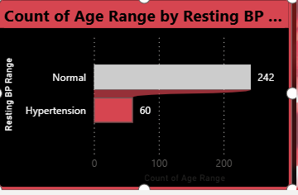

Count of Age Range by Resting BP
Count of Age Range by Resting BP
Normal: 242 patients
Hypertension: 60 patients
Insights: “Most patients (242) have normal blood pressure, but a significant portion (60 patients) have hypertension, which is a critical risk factor for heart disease.”

Slide 17

summary
1. Gender Differences
Males show a higher prevalence of high blood pressure, elevated cholesterol, and overall cardiovascular risk compared to females.
Indicates the need for male-focused preventive strategies, especially in the 40–60 age group.
2. Age Factor
Risk of heart disease increases significantly with age.
Cholesterol levels and blood pressure rise progressively from middle age to senior age.
Seniors (>60 years) are the most vulnerable group, requiring intensive monitoring.
3. Blood Sugar / Diabetes Link
28% of patients have high blood sugar, highlighting the strong correlation between diabetes and heart disease.
Emphasizes the importance of screening for diabetes as part of cardiac risk assessment.
4. Preventive Focus
Middle-aged and senior females, while lower in overall risk than males, still require early intervention.
Awareness and preventive lifestyle programs can significantly reduce late-stage heart disease in women.
5. Actionable Advice
Promote healthy lifestyle changes: balanced diet, exercise, and stress management.
Encourage regular monitoring: BP, cholesterol, blood sugar.
Implement gender- and age-targeted preventive programs for high-risk groups.
Focus on early detection to prevent severe cardiac events.

Slide 18

Conclusion / Takeaways
Heart disease risk is higher in males, but age and lifestyle increase vulnerability for all.
Diabetes and high cholesterol are major contributors to heart disease risk.
Targeted prevention and early detection are essential, especially for middle-aged and senior populations.
Implementing gender- and age-specific health programs can significantly reduce cardiac incidents.
Regular check-ups and lifestyle interventions remain the most effective strategies to combat heart disease.

